Slide 2
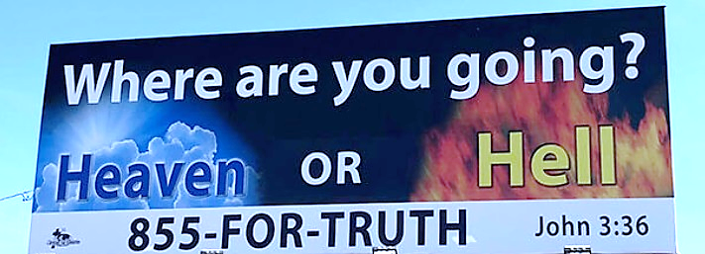

Slide 3
HOW DOES IT AFFECT YOU?

Slide 4
Christians Are Confident Of Their Salvation
John 16:20-22 “sorrow will be turned into joy”
Philippians 4:4 “Rejoice in the Lord always.”
1 Corinthians 15:19 “If in this life only we have hope in Christ, we are of all men the most pitiable.”
1 Peter 1:3 “has begotten us again to a living hope through the resurrection of Jesus Christ from the dead,”
Philippians 3:13,14 “I press toward the goal for the prize of the upward call of God in Christ Jesus.”

Slide 5
Christians Are Confident Of Their Salvation
Philippians 3:20,21 “our citizenship is in heaven”
1 Thessalonians 4:13-18 “For the Lord Himself will descend from heaven with a shout, with the voice of an archangel, and with the trumpet of God. And the dead in Christ will rise first. 17 Then we who are alive and remain shall be caught up together with them in the clouds to meet the Lord in the air. And thus we shall always be with the Lord.”
2 Timothy 4:7,8 “there is laid up for me the crown of righteousness, which the Lord, the righteous Judge, will give to me on that Day, and not to me only but also to all who have loved His appearing.”

Slide 6
Early Saint Did Not Live Under A Cloud Of Gloom
John 10:27-29 “I give them eternal life, and they shall never perish”
Epistle of 1 John written to assure Christians of their salvation
1 John 5:13 “you may know that you have eternal life, and that you may continue to believe in the name of the Son of God”
1 John 1:4 – “And these things we write to you that your joy may be full.”
Christian – is your joy full?

Slide 7
Assured Of Eternal Life If We Keep His Commandments
1 John 2:3-5 “we know that we know Him, if we keep His commandments…”
IF you want to be assured of your salvation, you must keep the commands of Christ!
It takes more than saying LORD, LORD to be saved by Jesus – Luke 6:46
1 John 2:5 connect the LOVE OF GOD with the OBEDIENCE OF MAN
God’s love will not save a person during and in spite of his disobedience!
John 10:27,28 “hear My voice,.. I know them,.. they follow Me.”

Slide 8
Assured Of Eternal Life If We Walk As He Walked
1 John 2:5,6 “ He who says he abides in Him ought himself also to walk just as He walked”
Live as He Lived – 1 John 1:7 “walk in the light, as he is in the light”
1 John 1:5 “God is light, and in him is no darkness at all,”
1 John 1:8-2:1 – Assures forgiveness if we confess sins to Him
Hebrews 12:1,2 “let us lay aside every weight, and the sin which so easily ensnares us, and let us run with endurance the race that is set before us”
1 Peter 2:21 “Christ also suffered for us, leaving us an example, that you should follow His steps:”

Slide 9
Assured Of Eternal Life If We Do What Is Righteous
1 John 2:29 “If you know that He is righteous, you know that everyone who practices righteousness is born of Him.”
“Practicing Righteousness” – doing what is right in God’s sight
Psalm 19:8,9 “judgments of the LORD are true and righteous altogether.”
Psalm 119:172 “For all Your commandments are righteousness.”
Acts 10:34,35 “whoever fears Him and works righteousness is accepted by Him.”
Galatians 3:26,27 “sons of God through faith in Christ Jesus”
Titus 3:4-7; Romans 9:15,16

Slide 10
Assured Of Eternal Life If We Love The Brethren
1 John 3:14,15 ”passed from death to life, because we love the brethren”
1 John 4:7,8 Love brethren is a child of God – not love is not!
1 John 5:2,3 “this is the love of God, that we keep His commandments”
Jesus obeyed the Father’s will– “laid down His life for us” 1 John 3:16
1 John 3:16-18 “we also ought to lay down our lives for the brethren” and loving “in deed and truth”
1 John 3:19 “we know that we are of the truth, and shall assure our hearts before Him”

Slide 11
The Christian’s Assurance Of Eternal Life Comes From Christ And Is Realized In Our Lives As We Live By Faith, Obeying His Will
1 John 5:11-12 NKJV 11 “And this is the testimony: that God has given us eternal life, and this life is in His Son. 12 He who has the Son has life; he who does not have the Son of God does not have life.”

